Slide 1
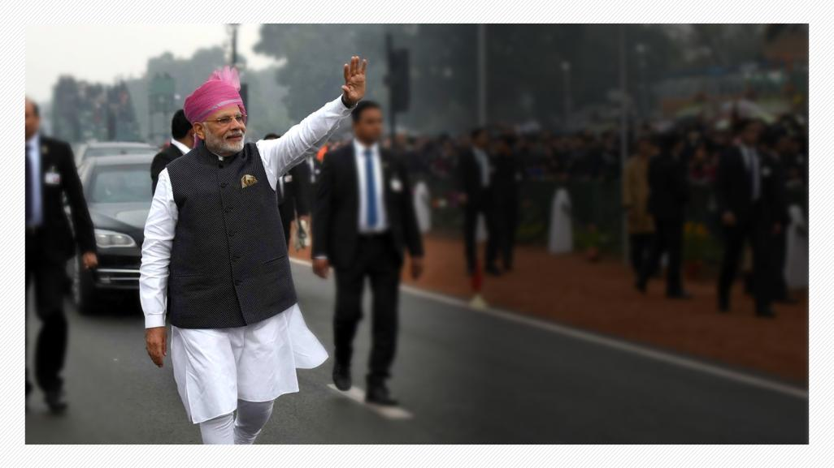
Photo Album
Speed, Scale and Spectrum
of Transforming India
by Windows User

Slide 2


Slide 3
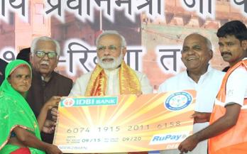



v
DEVELOPMENT FOR ALL
Jan Dhan Yojana Serving the Banking Needs of the Unbanked
33.66 crore
Jan Dhan accounts opened
According to the World Bank Findex Report, India accounts for
55% of new bank accounts opened globally between 2014-17
India Post Payments Bank launched with 650 Branches & 3250 Access Points taking banking system to doorstep of poor & unbanked
As on 1st January 2019

Slide 4
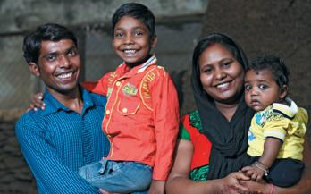




v
DEVELOPMENT FOR ALL
Jan Suraksha Yojana Gives Insurance to Poor
14.27 crore persons insured under PM Suraksha Bima Yojana at ₹12 per year
PM Jeevan Jyoti Bima Yojana benefitted 5.47 crore families at ₹330 per year
Atal Pension Yojana, for unorganised sector workers, has more than 1.24 crore subscribers
Financial security of senior citizens with PM Vaya Vandana Yojana, gives 8% interest for 10 years. Investment limit doubled to ₹15 lakh and scheme extended till 2020
As on 1st January 2019

Slide 5
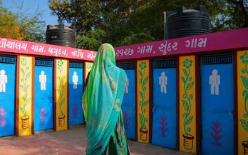



v
DEVELOPMENT FOR ALL
Swachh Bharat Mission Brings about a Sanitation Revolution
Rapid construction of toilets ensuring dignity of women & eradicating open defecation
Over 5.40 lakh Villages in 27 States & UTs declared Open Defecation Free
Over 9.67 crore
Toilets built
Sanitation coverage goes up from 38% in 2014 to 98.49% at present
As on 1st January 2019

Slide 6
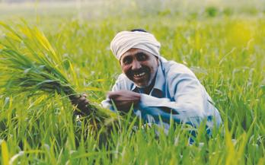
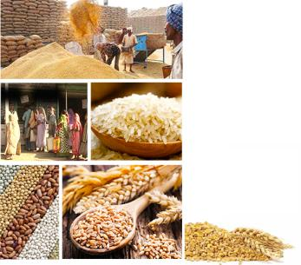
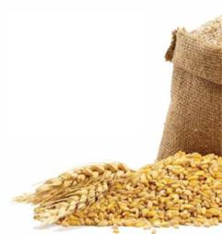
v
DEVELOPMENT FOR ALL
Ensuring Food Security for more than 80 Crore People
Food security
ensured in all the
36 States/UTs
as against 11 states
in May 2014
As on 1st January 2019

Slide 7



v
DEVELOPMENT FOR ALL
Direct Benefit Transfer Ensuring Money in Account, Removing Middlemen
World’s largest cash transfer program with over
₹5,67,918 crore
23.27 crore
directly transferred
into bank account of
beneficiaries of 434 schemes
beneficiaries receiving over ₹1,04,045 crore
As on 1st January 2019

Slide 8
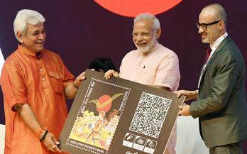






v
DEVELOPMENT FOR ALL
India Post Payments Bank
Delivering Doorstep Banking to the Unbanked
Launched on 1st September, 2018
Over 12 lakh
IPPB accounts
with a balance of over ₹13 crore
(as on 9th October 2018)
Products offered across multiple channels such as Micro-ATM, Mobile Banking
Providing savings & current accounts, bill & utility payments & other services
3 lakh Postmen & over
2.6 lakh Gramin Dak Sevaks
delivering IPPB services
As on 1st January 2019

Slide 9
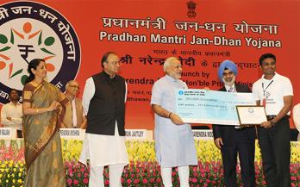






v
DEVELOPMENT FOR ALL
Boost to Financial Services with PM Jan Dhan Yojana
Accidental insurance
cover for new RuPay card
holders raised from
`1 lakh to `2 lakh
Overdraft limit
raised from
`5000 to `10,000
No conditions for
overdraft
up to `2000
Accidental insurance
cover for new RuPay card
holders raised from
₹1 lakh to ₹2 lakh
Overdraft limit
raised from
₹5000 to ₹10,000
No conditions for
overdraft
up to ₹2000
Age limit for availing
overdraft facility increased from
18-60 to 18-65 years
Age limit for availing
overdraft facility increased from
18-60 to 18-65 years
As on 1st January 2019

Slide 10


Slide 11
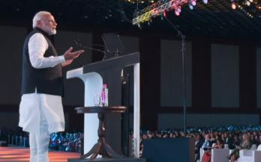




THE WORLD SEES A NEW INDIA
India Becomes the Global Growth Engine
India remains the world’s fastest growing large economy
India’s GDP in Current Prices increased by 31% between 2013 & 2017 while the Global GDP increased by 4%
India rated highly on all investment and macro-economic indicators
As on 1st January 2019

Slide 12



THE WORLD SEES A NEW INDIA
Yoga Goes Global
Ahead of International Yoga Day, United Nations headquarters lit up in New York
Entire world celebrates Yoga Day on 21st June with great enthusiasm
Yoga inscribed on the Representative List of the Intangible Cultural Heritage of Humanity in the UNESCO0
As on 1st January 2019

Slide 13
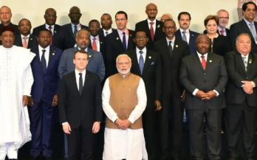






THE WORLD SEES A NEW INDIA
India Leads the Fight Against Climate Change
India played a leading role at COP21
in Paris
India spearhead
Solar Alliance with a commitment of
₹175 crore for setting up of ISA
PM Modi inaugurated the first assembly of ISA on
October 2, 2018
Cabinet approved resolution to open ISA membership to all countries that are members of UN on Nov. 1, 2018
As on 1st January 2019

Slide 14
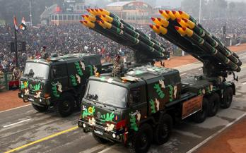

THE WORLD SEES A NEW INDIA
Protecting Motherland with
Full Might
In a historic first, India carried out Surgical Strikes showing a new mettle
Long pending demand of One Rank One Pension Fulfilled
Modernisation of Defence forces going on at full pace
INS Arihant completed its first deterrence patrol, establishing India’s Nuclear Triad
As on 1st January 2019

Slide 15
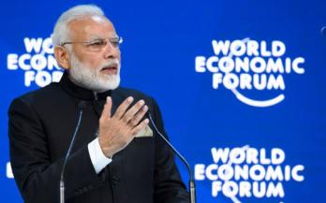




THE WORLD SEES A NEW INDIA
New Might of a
New India
In a historic first, the world heard the India Story from PM Modi at World Economic Forum Davos
India secured representation in International Tribunal for the Law of the Sea, International Maritime Organization & Economic and Social Council
Subsequent to inclusion in MTCR in 2017, India secures membership of Wassenaar Arrangement & Australia Group in 2018
In the last 4 years,
India’s relations with
other nations have
seen significant
improvement
As on 1st January 2019

Slide 16
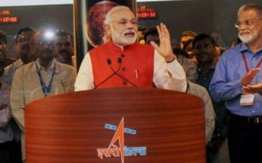

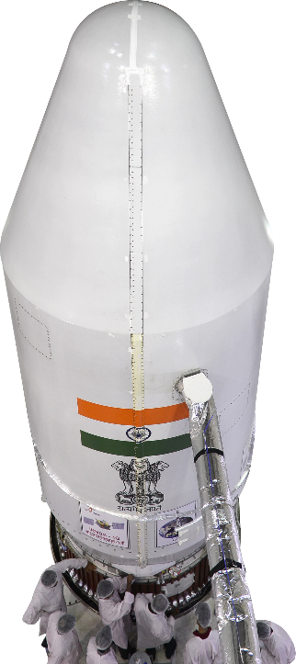

THE WORLD SEES A NEW INDIA
Jai Vigyaan
ISRO sets a World Record by launching
104 Satellites in a single flight
India’s most-advanced communication satellite GSAT 11 & multi-band satellite GSAT-29 launched to increase Hi-speed communication and broadband facilities
With IRNSS-1G, India joined elite list of countries with their own satellite navigation system NavIC.
First Asian country to launch Mars Orbit Mission with Mangalyaan
As on 1st January 2019

Slide 17
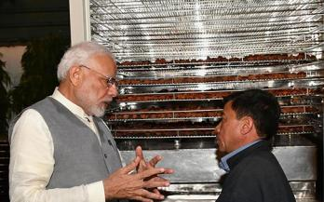


THE WORLD SEES A NEW INDIA
India leading the Global Shift towards Renewable Energy
India’s Standing in Global Renewable Energy Installed Capacity
Wind Power
Solar Power
Renewable Energy
4th
5th
5th
Renewable energy installed capacity
73.35 GW
In last 4 years, Govt. has invested over
USD $40 billion in green energy space
35.51 GW
2014
Oct 2018
As on 1st January, 2019

Slide 18


Slide 19
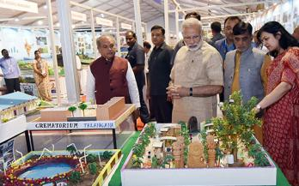







PUTTING FARMERS FIRST
Multi-faceted Focus on Doubling
Farmers’ Incomes
Special focus on irrigation with the aim of
“Per Drop More Crop”
Creation of a National Farm Market, removing distortions and e-platform across 585 Stations
Provision of quality seeds and nutrients
based on soil health of each field
Introduction of a New Crop Insurance Scheme
to mitigate risks at an affordable cost
Large investments in Warehousing and Cold Chains to prevent post-harvest crop losses
Promotion of ancillary activities like poultry, beekeeping and fisheries
Promotion of value addition through food
processing
As on 1st January 2019

Slide 20
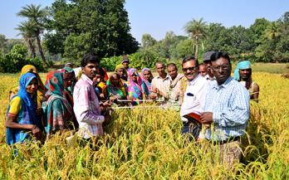






PUTTING FARMERS FIRST
Record Budgetary Allocation for
Record Outcomes
Farm Credit Target raised to
₹11 lakh crore for 2018-19
₹2,000 cr for Agri-market infrastructure fund set up
Corpus of ₹10,000 cr
to create infrastructure in fishery, aquaculture and animal husbandry sectors
₹1,290 cr allocated under
National Bamboo Mission to help setting up small industries
Tax incentives to promote
post-harvest agricultural activities
As on 1st January 2019

Slide 21
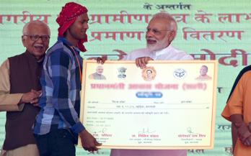





PUTTING FARMERS FIRST
Standing with Farmers in Times
of Need
Relief to farmers in distress given in case of 33% and more damage to the crop;
earlier it was for 50%
For food grains damaged due to excessive rainfall, full minimum support price
to be paid
Families of the deceased persons to be given an assistance of ₹4 lakhs,
up from ₹2.5 lakhs
82% rise in provision under SDRF* during 2015-20, as compared to 2010-15.
It went up to ₹61,220 Crore from ₹33,580.93 Crore
*State Disaster Relief Fund
As on 1st January 2019

Slide 22
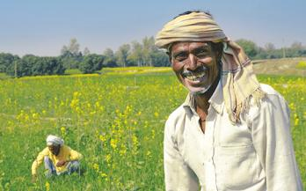



PUTTING FARMERS FIRST
Unprecedented Support to Farmers with Record Procurement
64 lakh metric tonnes of Pulses and Oilseeds were procured at MSP from farmers in 2014-18
Extent of buffer stock of Pulses
increased from 1.5 lakh tonnes to 20 lakh tonnes
Record procurement of 45.43 lakh metric tonnes of pulses under Price Support Scheme
As on 1st January 2019

Slide 23
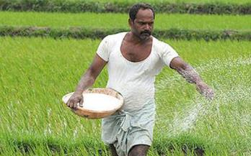






PUTTING FARMERS FIRST
Greater Access and Availability of Fertilizers
100 % Neem Coating resulted in improvement in soil health, reduction in pest and disease attack
Led to Increased Nitrogen Use Efficiency and increased crop yield
Special Banking arrangement of ₹10,000 cr to clear fertilizer subsidy dues
Significant increase in Urea
Production with New Urea Policy
A reduction in the MRP of DAP*, MOP** and Complex fertilizers
*Diammonium Phosphate
**Muriate of Potash
As on 1st January 2019

Slide 24
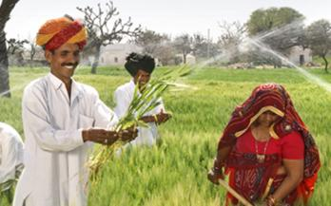





PUTTING FARMERS FIRST
Ensuring More Crop Per Drop
Pradhan Mantri Krishi Sinchai Yojana
Rs. 50,000 crores to be invested
to achieve ‘Har Khet Ko Paani’
Dedicated Micro Irrigation fund of
Rs. 5000 crores
₹ 50,000 crores to be invested
to achieve ‘Har Khet Ko Paani’
Dedicated Micro Irrigation fund of
₹ 5000 crores
Over 33 lakh hectare
covered under micro irrigation since 2014
Facilitating farmers for installing
solar water pumps in field irrigation
Over 31.03 lakh hectare covered
under micro irrigation since 2015-16
Facilitating farmers for installing
solar water pumps in field irrigation
As on 1st January 2019

Slide 25





PUTTING FARMERS FIRST
Helping Farmers get the
Right Price
Electronic National Agriculture Market e-NAM
e- Trading platforms,
585 regulated markets to fetch best prices for farmers
More than 1.41 crore farmers
and sellers are registered
Over 2.25 crore tonnes of farm commodities worth ₹58,930 crore transacted on e-NAM
As on 1st January 2019

Slide 26





PUTTING FARMERS FIRST
Unprecedented Price Support to Sugarcane Industry
Raise in Procurement Price of Ethanol derived from sugarcane juice
₹52.43/L
₹59.13/L
₹47.13/L
₹47.13/L
Financial assistance of ₹13.88/quintal
to sugar mills to clear cane dues of farmers
Partial sugarcane juice
100% sugarcane juice
Assistance to sugar mills towards transport & logistics
₹1000/MT
Mills within 100 Kms from ports
₹2500/MT
Mills beyond 100 Kms from port in coastal States
₹3000/MT
Mills beyond 100 Kms from port
other than coastal states
As on 1st January 2019

Slide 27
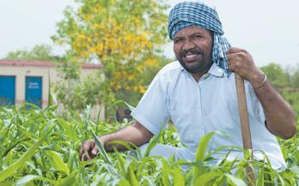




PUTTING FARMERS FIRST
Historic Rise in MSPs of All Kharif Crops
Hike in MSP for all
14 Kharif crops to be
marketed in 2018-19
Season
Raise in MSP ranging
from ₹200 to ₹1827 per quintal
Ensuring 50% to 97%
return over cost of
production
To boost production,
improve nutritional
security & reduced import
As on 1st January 2019

Slide 28
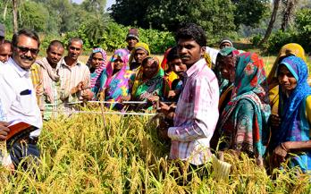






PUTTING FARMERS FIRST
Unprecedented Hike in MSP of All Rabi Crops
Cost of production per quintal
MSP (2019-20)
*Return over cost of production (%)
Wheat
Masur
Gram
₹1840
₹4475
₹4620
112.5%*
76.7%*
75.2%*
₹866
₹2532
₹2637
Barley
Rapeseed & Mustard
Safflower
₹1440
₹4200
₹4945
67.4%*
89.9%*
50.1%*
₹860
₹221
₹3294
As on 1st January 2019

Slide 29





PUTTING FARMERS FIRST
Ensuring Remunerative Prices to Farmers
PM Annadata Aay Sanrakshan Abhiyan launched
Price Support
Scheme (PSS)
Price Deficiency Payment
Scheme (PDPS)
Pilot of Private
Procurement & Stockist
Scheme (PPPS)
Government guarantee
increased to
Physical procurement of pulses, oilseeds & Copra by Nodal Agencies.
Govt. to bear procurement expenditure & losses
To cover all oilseeds for
which MSP is notified.
Farmers to get direct payment to the difference between MSP & selling price
Private sector participation in procurement operation to be piloted
₹45,550 crore
As on 1st January 2019

Slide 30
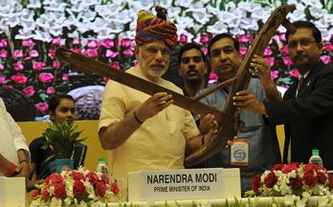



PUTTING FARMERS FIRST
Agricultural Growth Gathers New Momentum
Agricultural Growth
4.55%
3.8%
2.8%
H1
H2
2017-18
H1
2018-19
As on 1st January 2019

Slide 31
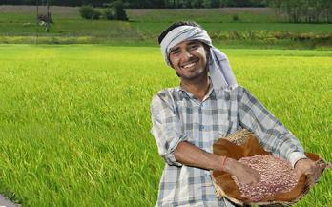




PUTTING FARMERS FIRST
Agriculture Export Policy 2018
Double agricultural exports from present $ 30+ billion to over $60 billion by 2022
Farmers to get benefit of export opportunities in overseas market
Promote ethnic, organic & traditional and non-traditional Agri products exports
Establish Monitoring Framework to oversee implementation of Agricultural Exports Policy
As on 1st January, 2019

Slide 32
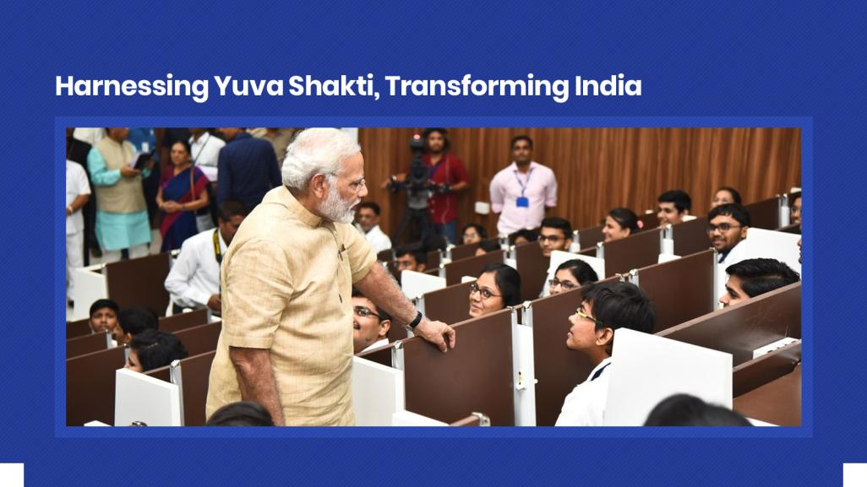

Slide 33
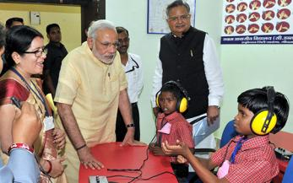









HARNESSING YUVA SHAKTI
Transforming Education, Furthering Empowerment
Overhauling the School Education Apparatus
For building
innovative skills
5,441 Atal Tinkering Labs sanctioned in schools to engage over 60 lakh
students
To boost
educational infrastructure in tribal areas, 462 new
Eklavya Model Residential Schools
to be set up
54,000 ramps & railings built and 50,000 special toilets for Divyang children
As on 1st January 2019

Slide 34
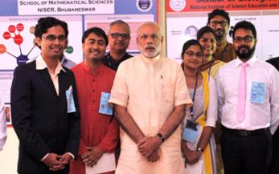




HARNESSING YUVA SHAKTI
Transforming Education,
Furthering Empowerment
Numerous universities, 7 IITs, 7 IIMs, 14 IIITs, 1 NIT, 2 IISER, 103 KVs & 62 Navodaya Vidyalayas established and made operational
Recognizing talent with PM Research Fellowship Scholarship worth ₹70,000-₹80,000 per month for 5 years and ₹2 lakh annual grant for PhD & research
20 institutes declared as “Institute of Eminence”
As on 1st January 2019

Slide 35
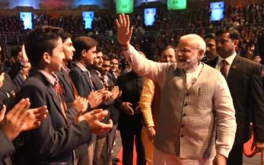



HARNESSING YUVA SHAKTI
Transforming Education,
Furthering Empowerment
60 universities granted graded autonomy. Quality Institutes granted autonomy by passing IIM Bill
National Testing Agency to conduct all professional exams as per International Standard
Vigorous attention devoted to teacher training to produce top quality teachers
As on 1st January 2019

Slide 36
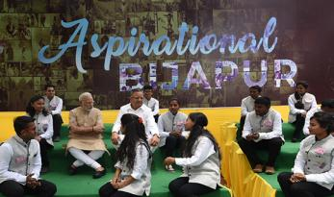






HARNESSING YUVA SHAKTI
Harnessing Yuva Shakti
through Self-Employment
15,005 Start-ups recognised so far
Tax relief for three consecutive years out of a block of seven years for start-ups
Start-ups are allowed to issue ESOPs to promoters working as employees
Funding the unfunded through Mudra Yojana
15.33 Crore Mudra loans sanctioned since April 2015
Allocation in Budget 2018
raised to ₹ 3 lakh crore,
a rise of 20% over previous year
As on 1st January 2019

Slide 37
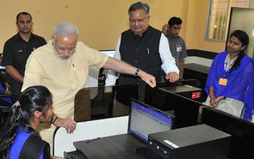
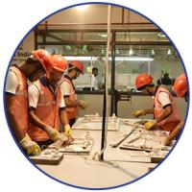
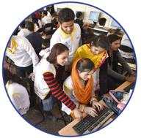
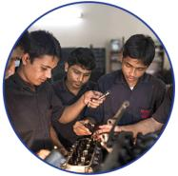

HARNESSING YUVA SHAKTI
Augmenting the Arena of Skill
Development & Vocational Training
Pradhan Mantri Kaushal Vikas Yojana
Over 1 crore youngsters to achieve training
13,000 training centres opened across India training in 375 trades
PM Kaushal Kendras
(PMKK) are being set up in every district across India
As on 1st January 2019

Slide 38
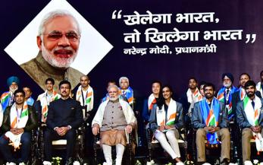





HARNESSING YUVA SHAKTI
Furthering Sports & Sportsmanship Khelo India
Financial assistance of ₹5 lakh/annum for 8 years to talented players
First Khelo India School Games launched on Jan 2018, 3507 players from 29 States and 7 UTs participated
Revamped Khelo India program to have a financial outlay of
₹1,756 crore for 2017-18 to 2019-20
Sports Talent Search Portal launched
A transparent platform for talented youth to share their achievements
As on 1st January 2019

Slide 39


Slide 40






WOMEN LED DEVELOPMENT
Facilitating Well-being of
Expectant Mothers
Maternity Benefit (Amendment) Act 2017
Paid maternity leave extended to 26 weeks (6 months), one of the highest duration in the world so far
49.88 Lakh women paid maternity benefit worth
₹1678.63 Crore (as on 10 December 2018)
Poshan Abhiyan
First of a kind initiative to tackle malnutrition through multi-modal intervention
Aims to reduce malnutrition, convergence with different ministries, targeted approach with technology
As on 1st January 2019

Slide 41
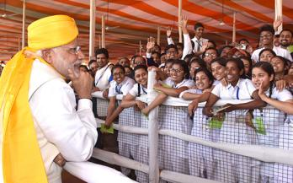




WOMEN LED DEVELOPMENT
From Women Development to Women-led development
Beti Bachao, Beti Padhao
Sex ratio at birth improved
in 104 identified districts
Rising enrollment
of girls in secondary schools
Multiple scholarship
for education of girls
119 districts have reported progress in first trimester registration
146 districts
have reported improvement
in institutional deliveries
As on 1st January 2019

Slide 42
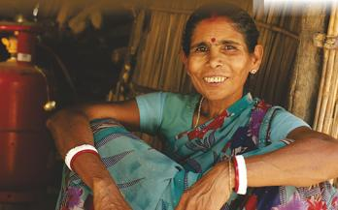



WOMEN LED DEVELOPMENT
From Women Development to
Women-led development
Pradhan Mantri Ujjwala Yojana
Target to provide LPG connections enhanced to 8 Cr Women & benefits extended to all left out poor families
Designed to improve
lives of women by abolishing
consumption of unhealthy fuels
5.85 Cr women
have got LPG connections
As on 1st January 2019

Slide 43







WOMEN LED DEVELOPMENT
Supplementing skills and supplying capital for Nari Shakti
This scheme provides collateral free loans to entrepreneurs
This initiative provides loans of up to ₹1 crore to women /SC/ST/OBC entrepreneurs
More than 74% of the beneficiaries are women
Over 9 crore women have benefitted jointly from Mudra & Stand-Up India
As on 1st January 2019

Slide 44



WOMEN LED DEVELOPMENT
Securing Women Against Violence
Ordinance on Death Penalty for rapists
Provision of Death Penalty for rape of girl child under 12 years
Minimum punishment for rape of a girl under 16 years increased from 10 years to 20 years
As on 1st January 2019

Slide 45







WOMEN LED DEVELOPMENT
Promoting Social Empowerment
for Women
Social Empowerment of Women
Putting women ahead
Bill that empowers Muslim Women against Triple Talaq passed in Lok Sabha
Preference given to Women in Pradhan Mantri Awas Yojana
Muslim Women can now perform Haj without a male guardian
Passport rules relaxed for single mothers
As on 1st January 2019

Slide 46
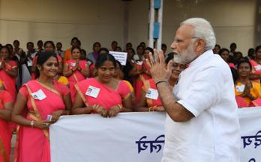




v
WOMEN LED DEVELOPMENT
Historic Pay Hike for Anganwadi Workers
Monthly Honorarium
Existing
Revised
About 27 lakh Anganwadi Workers &
Anganwadi Helpers to benefit
₹4500
₹10649.41 crore allocated from 1st Oct. 2018 to 31st March 2020
₹3000
₹3500
₹2250
Monthly performance linked incentive of ₹250 to Anganwadi helpers
₹2200
₹1500
Enhanced rate to be effective from
1st Oct. 2018
Anganwadi workers
Anganwadi worker at Mini- AWC
Anganwadi helpers
As on 1st January 2019

Slide 47
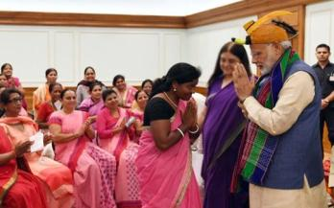





v
WOMEN LED DEVELOPMENT
Empowering ASHA Workers with Benefit Package
ASHAs & ASHA facilitators to be enrolled in Social security scheme
Routine incentives increased from ₹1000/month to ₹2000/month
Over 1.06 crore ASHAs & ASHA facilitators to be covered under PM Jeevan Jyoti Bima Yojana
Over 10.22 lakh ASHAs to benefit
Supervisory visit charge raised from ₹250 to ₹300/visit, a cumulative increase of ₹1000/month
Over 9.57 lakh ASHAs & ASHA facilitators to be covered under PM Suraksha Bima Yojana
As on 1st January 2019

Slide 48
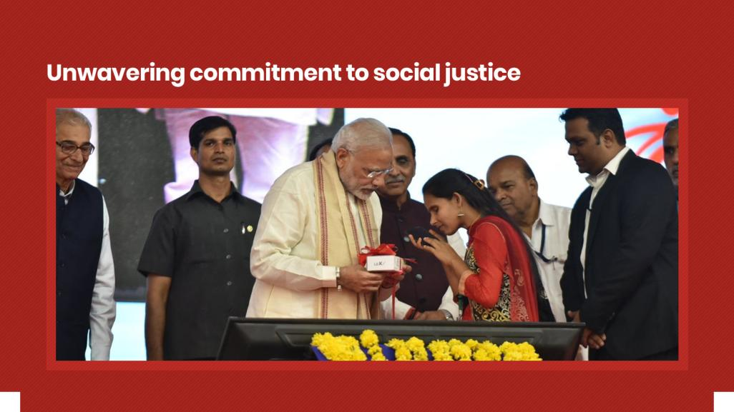

Slide 49






COMMITMENT TO SOCIAL JUSTICE
Fulfilling Aspirations
through Social Inclusion
Historic budget of
for welfare of SC/ ST
Communities
Rs. 95,000 crores
Over 5.7 crore students received scholarship support worth ₹15,918 crore during 2014-2018
Pre-Matric Scholarship for OBCs: Income eligibility raised from ₹44,500 to ₹2.5 lakh
Pre-Matric Scholarship for SC students: Income eligibility raised from ₹2 lakh to ₹2.5 lakhs
Unprecedented rise of 41% in the budget allocation
for OBC welfare in
2018-19 over 2017-18.
As on 1st January 2019

Slide 50
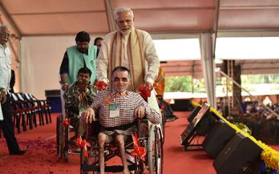




COMMITMENT TO SOCIAL JUSTICE
Accessible India,
Accomplished India
Converting at least 50% of all government buildings in the national capital and all state capitals
“fully accessible”
Special camps organized for distribution of Aids and Assistive devices to 10.5 lakh persons with disabilities
Sugamya Bharat
Abhiyan launched by
the Government on 3rd Dec 2015 to provide dignity to Divyangs
Access Audit of 1662 important buildings in 50 cities completed till date
As on 1st January 2019

Slide 51
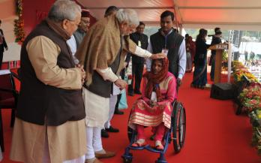




COMMITMENT TO SOCIAL JUSTICE
Setting the Stage for Social Empowerment Rights of Persons
With Disabilities Act, 2016
Types of disabilities increased from existing 7 to 21
Speech and Language Disability and Specific Learning Disability have been added for the first time
Acid Attack Victims have been included
Right to free education for children with disabilities (6-18 yrs) and Reservation of 4% seats for students in higher education institutions
Penalties for offences committed against Persons with Disabilities (PwDs)
As on 1st January 2019

Slide 52







COMMITMENT TO SOCIAL JUSTICE
Leaving No Stone Unturned
for Justice Strongest Amendments
to SC/ST Act
Establishment of exclusive special courts for the speedy trial of offences of atrocities against SCs & STs
To insert a new chapter relating to “Rights of Victims and Witnesses”
To impose certain duties and responsibilities upon the State for protection of victims, their defendants and witnesses
As on 1st January 2019

Slide 53
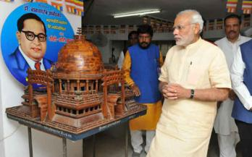
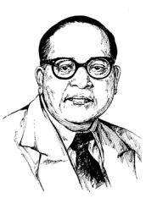



COMMITMENT TO SOCIAL JUSTICE
Connecting Young India to
Dr. Babasaheb Ambedkar
Panchteerth: Paying Tribute to Babasaheb by Developing Places Associated with his Life
His birthplace in Mhow
His residence during studies in the U.K.
Deeksha Bhoomi, Nagpur,
where he embraced Buddhism
Dr. Ambedkar International Centre opened in Dec 2017. Foundation stone was laid by PM Modi in April 2015.
Where he attained Parinirvan,
‘Mahaparinirvan Sthal’ in Delhi
His memorial,
‘Chaitya Bhoomi’ in Mumbai
As on 1st January 2019

Slide 54
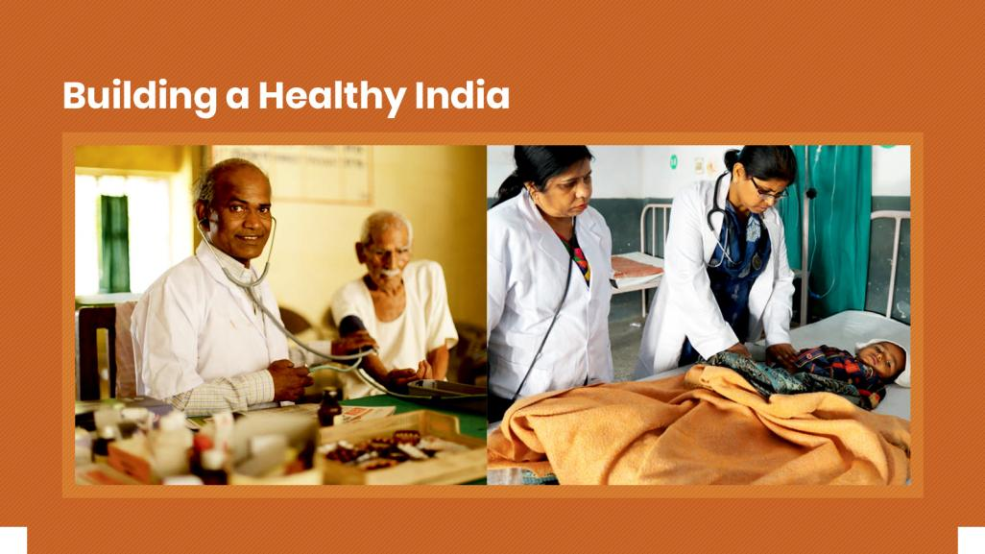

Slide 55
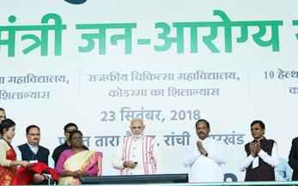




t
HEALTHY INDIA
Health insurance
cover of up to
₹ 5 lakh/family/yea
Ayushman Bharat
PM Jan Arogya Yojana for Universal Health Coverage
Launched on 23rd September, 2018
Health insurance
cover of up to
₹5 lakh/family/year
Covers secondary
and tertiary care hospitalisation
Providing free treatment in any public or over 16,000 empanelled private hospitals across the country
Over 41.45 lakh beneficiary e-cards generated and over 6.95 lakh persons have been treated since the launch
As on 1st January 2019

Slide 56
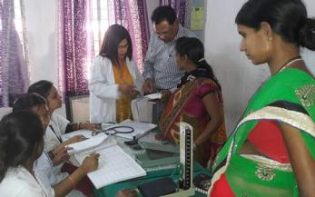




t
HEALTHY INDIA
Health insurance
cover of up to
₹ 5 lakh/family/yea
Ensuring Good Health of
Mother & Child
More than
1.6 Cr
Antenatal check-ups
conducted at over
13,161 health facilities
86.8 lakh
pregnant women
immunized
More than
50 lakh
pregnant women
to benefit every year
with cash incentives of
₹ 6,000
Nearly
8 lakh
high risk pregnancies identified
As on 1st January 2019

Slide 57
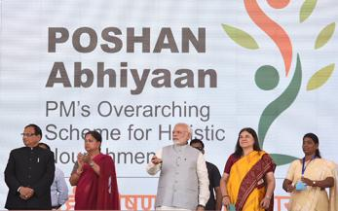


t
HEALTHY INDIA
Health insurance
cover of up to
₹ 5 lakh/family/yea
POSHAN Abhiyaan to Ensure
Proper Nutrition
First of its kind initiative launched to tackle Malnutrition through multi-modal
interventions
Target to reduce Malnutrition through
Convergence, Use of Technology & a
Targeted approach
As on 1st January 2019

Slide 58
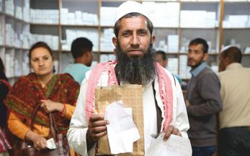




t
HEALTHY INDIA
Health insurance
cover of up to
₹ 5 lakh/family/yea
Ensuring Affordable & Quality Healthcare
1084 essential medicines brought under Price Control regime giving consumer total benefit of more than ₹15,000 crore
Price of Cardiac Stents reduced by 85%
Affordable medicines with PM Bhartiya
Janaushadhi Kendras. More than 4,635 stores, resulting in savings of over 50%-90%
Price of Knee Implants reduced by 69%
AMRIT pharmacies provide drugs for cancer and
cardiovascular diseases at a discount of 60% to 90%
As on 1st January 2019

Slide 59







t
HEALTHY INDIA
Health insurance
cover of up to
₹ 5 lakh/family/yea
Quality and Affordable Health
Provide free dialysis
services to poor &
subsidized services
to all patients
497 dialysis units have been made operational
Pradhan Mantri National
Dialysis Program
About 2.5 lakh
patients have availed the service
Nearly 25 lakh
dialysis session
held so far
As on 1st January 2019

Slide 60






t
HEALTHY INDIA
Health insurance
cover of up to
₹ 5 lakh/family/yeai
Eliminating Diseases
One Dose at a Time
India has validated Elimination of
Maternal & Neonatal tetanus in May 2015, before the global target of Dec 2015
MISSION INDRADHANUSH
completed five phases covering 551 districts
(7 Dec. 2018)
Action plans to eliminate Leprosy by 2018, Measles by 2020 and Tuberculosis by 2025 implemented
86.8 lakh pregnant
female immunized
3.37 crore children
vaccinated
As on 1st January 2019

Slide 61






t
HEALTHY INDIA
Health insurance
cover of up to
₹ 5
Standardization of Allied Healthcare Professionals
Allied and Healthcare Professions Bill, 2018
Setting up of Allied & Healthcare Council of India
& corresponding State Allied Healthcare Councils
15 major professional categories including 53 professions
To directly benefit around 8-9 lakh existing healthcare professionals
Global demand of healthcare workforce projected to be about 15 million by 2030
(WHO Global Workforce, 2030 Report)
Councils to play the role of standard-setter and regulator
As on 1st January 2019

Slide 62


Slide 63



INFRASTRUCTURE FOR NEW INDIA
Building Homes, Nurturing Dreams
Pradhan Mantri Awas Yojana
When India turns 75 in 2022, every Indian should have his or her own home
Loans up to ₹9 lakh and ₹12 lakh get interest subvention of 4% and 3%
Over 1.48 crore
houses built since 2014
As on 1st January 2019

Slide 64



INFRASTRUCTURE FOR NEW INDIA
Urban Transformation through Smart Cities
100 urban centres chosen as Smart Cities to ensure improved quality of living, sustainable urban planning and development
Various development projects in these cities will cost ₹2,05,018 crores and positively impact about 10 crore Indians
As on 1st January 2019

Slide 65




INFRASTRUCTURE FOR NEW INDIA
More Roads and Highways, Greater Transformation
Expansion of National Highways
EXPENDITURE ON
ROAD CONSTRUCTION
NATIONAL HIGHWAY
NETWORK EXPANDED
SPEED OF CONSTRUCTION
INCREASED
₹1,16,324
crores
1,20,543
km
27 km
per day
Over 1.89 lakh kilometers of rural roads built since 2014
Rural road connectivity up from 56% in 2014 to 91%
92,851
km
12 kms
per day
(as on 9th Aug ‘18)
₹32,483
crores
Average speed of road construction goes up from 69 km/day (2013-14) to 134 km/day (2017-18)
Enhanced road connectivity in every village by 2019 in inaccessible areas
2013-14
2017-18
2013-14
2017-18
2013-14
2017-18
2,000 kms of coastal connectivity roads identified for construction and development
As on 1st January 2019

Slide 66




INFRASTRUCTURE FOR NEW INDIA
Railways Development on Track
BEST EVER SAFETY
RECORD IN 2017-18
9,528 kms
in 4 years
Less than 100 accidents recorded
in a year. 62% reduction in consequential train accidents
4,405 kms
7,600 kms
in 5 years
2,926 kms
118
73
North East is fully integrated with rest of India with the entire network converted to Broad Gauge
2009-14
2014 - Mar18
2009-14
2014 - Mar18
BROAD GAUGE LINE COMMISSIONED
50% INCREASE IN TRACK RENEWAL
2013-14
2017-18
As on 1st January 2019

Slide 67









INFRASTRUCTURE FOR NEW INDIA
Promising Affordable Air Travel Ude Desh ka Aam Nagrik
India emerges as the world’s third largest aviation market
Passenger traffic growth in the range of 18-20% over the past 3 years
For the first time, more people traveled in airplanes than in AC trains
102 operational airports since Independence, UDAN added 34 airports
Domestic air passengers crossed 100 million in 2017
National Civil Aviation Policy-2016 unveiled to transform the sector
Regional air connectivity to unserved & underserved airports at subsidized fare of ₹2,500 per hour
As on 1st January 2019

Slide 68




INFRASTRUCTURE FOR NEW INDIA
Deadweight Tonnage*
Harnessing Inland Waterways to Boost Connectivity
India’s First Inland Waterways Terminal on River Ganga Inaugurated
102 operational airports since Independence, UDAN added 34 airports
Regional air connectivity to unserved & underserved airports at subsidized fare of ₹2,500 per hour
First of the 4 multi-modal terminals constructed on National Waterways – I
Completed in a record time under Rs 5369 crore Jal Marg Vikas Project
Enable commercial navigation of vessels of 1,500-2,000 DWT* capacity
Deadweight Tonnage*
As on 1st January 2019

Slide 69



INFRASTRUCTURE FOR NEW INDIA
Thrust to Environment Friendly & Cheaper Fuel
2 crore
PNG connections
& 4,600 CNG stations to be installed in 8 years to cover 70% of population
Foundation Stones laid for City Gas Distribution (CGD) projects in 129 districts
10th CGD Projects Bidding Round launched to cover additional 124 districts
CGD Projects
in 96 cities benefiting 46.5 lakh households & 32 lakh CNG vehicles
(till Sept. 2018)
As on 1st January 2019
CNG is cheaper by 60% & 45% as compared with Petrol and Diesel respectively & PNG is cheaper by 40% as compared to market price LPG

Slide 70






INFRASTRUCTURE FOR NEW INDIA
mv
100% Electrification of Broad Gauge Routes of Indian Railways
₹12,134.50 Cr allocated to
cover 13,675 route kilometres
Railways to save fuel bill up to ₹13,510 Cr per annum
To reduce fossil fuel consumption by
2.83 billion litre/annum
Generate direct employment of
about 20.4 Cr man-days
during construction
As on 1st January 2019

Slide 71





INFRASTRUCTURE FOR NEW INDIA
Deadweight Tonnage*
Significant Steps taken to Clean Ganga
102 operational airports since Independence, UDAN added 34 airports
254 projects worth ₹24,672 Cr sanctioned under Namami Gange program
131 projects sanctioned for 3076 MLD* new sewage treatment plants (STPs)
Rehabilitation on 887 MLD of existing STPs & 4942 km sewer network
10,83,688 household Toilets constructed
& all 4465 villages made ODF
Regional air connectivity to unserved & underserved airports at subsidized fare of ₹2,500 per hour
*Millions of Litre Per Day
As on 1ST January, 2019
As on 3rd December, 2018

Slide 72


Slide 73





ACCELERATING GROWTH
Bold Reforms,
Stronger Institutions,
Resurgent Economy
Opened commercial coal mining sector to private players
Home-buyers’ dreams & rights protected with Real Estate Regulation
Act (RERA)
Transparent
resource allocation with 89 coal
mines allocated
Disinvestment
crossed target of
₹72,500 crore
As on 1st January 2019

Slide 74




ACCELERATING GROWTH
Banking Reforms Fueling the Next Wave of Growth
Historic Insolvency and Bankruptcy Code
leading to significant
results
Approval
for PSBs to amalgamate through alternative mechanism to facilitate consolidation
PSBs
recapitalized
by infusing
₹2,11,000 crore to support credit growth & job creation
As on 1st January 2019

Slide 75




ACCELERATING GROWTH
Ease of Compliance
Ensuring Labour Welfare
Shram Suvidha portal:
Unique Labour identification number allocated, online registration of establishments
Employees don’t undergo hassles to transfer EPFO accounts any more: Universal Account Number (UAN) boosts portability
The Payment of Wages (Amendment) Act 2017: Empowering workers
As on 1st January 2019

Slide 76





ACCELERATING GROWTH
GST Enhancing Ease of Doing Business and Ease of Living
Small traders
& consumers
benefit
with end of
multiplicity of
taxes
Overall
reduction
in prices
Significant
decrease in
transport
time with
elimination of
check-posts
Reduction in
cascading
effect
of taxes
As on 1st January 2019

Slide 77





ACCELERATING GROWTH
Enhancing Growth, Simplicity and Transparency with GST
Over 57.5 Lakh New taxpayers registered post GST
(till 30th November 2018)
More than
₹ 91,149 Cr
of GST refunds disposed off
₹ 7909.96 Cr
Recovered from GST tax evasion during April - November 2018
Above 98%
Items fall
in/below 18% slab
As on 1st January 2019

Slide 78


ACCELERATING GROWTH
India : A Leading Mobile
Manufacturing Hub
Then
Now
Mobile manufacturing units set up
2
127
Mobile handsets
produced
6 Cr
22.5 Cr
Worth of mobile
handsets produced
₹18,992
crore
₹1.32 lakh
crore
As on 1st January 2019

Slide 79






ACCELERATING GROWTH
Strong Macro Economic Fundamentals define India
Economy growing at a robust rate, with GDP growth at 7.6% in First Half of FY 2018-19
Falling Overall Inflation
Food Inflation Down
8.48%
9.19%
4.58%
3%
APRIL 2014
APRIL 2018
APRIL 2014
APRIL 2018
As on 1st January 2019

Slide 80





ACCELERATING GROWTH
India becomes the
Global Growth Engine
31%
3.2%
4%
2.43%
1.75%
2013
2018
2005
2013
2017
GDP growth rate at Current Prices
Growth in India’s share in World GDP
As on 1st January 2019

Slide 81



ACCELERATING GROWTH
India Transforms,
the World Applauds
India Climbed to the 40th rank
WEF’s Global Competitiveness Index
India’s ranking in Ease of Doing Business
leapt 65 places since 2014
77
40
100
71
130
142
2014-15
2017-18
2014
2016
2017
2018
As on 3rd December, 2018

Slide 82







ACCELERATING GROWTH
India’s Significant Jump in
Ease of Doing Business Ranking
Rank in Key Performance Indicators
CONSTRUCTION
PERMITS
GETTING
ELECTRICITY
RESOLVING
INSOLVENCY
2018
2018
2018
52
24
108
2014
2014
2014
184
137
137
TRADING
ACROSS BORDERS
PAYING TAXES
STARTING
A BUSINESS
2018
2018
2018
80
121
137
2014
2014
2014
126
156
158
As on 1st January 2019

Slide 83

ACCELERATING GROWTH
India’s Growth Gathers New Momentum
7.6%
7.35%
GDP growth at 7.6% in First Half of FY 2018-19
5.95%
H1
H2
H1
2017-18
2018-19
As on 1st January 2019

Slide 84



ACCELERATING GROWTH
Manufacturing Growth Gathers New Momentum
Manufacturing GVA
10.45%
7.1%
5.3%
H1
H2
H1
2017-18
2018-19
As on 1st January 2019

Slide 85



ACCELERATING GROWTH
Growth Rate of Sale of Commercial Vehicles Gathers New Momentum
Growth Rate of Sale of Commercial Vehicles
51.6%
33.9%
30.9%
21%
0
-9.1%
Q1
Q2
Q3
Q4
Q1
2017-18
2018-19
As on 1st January 2019

Slide 86






ACCELERATING GROWTH
PM Unveiled 12 Key Initiatives for Growth of MSMEs
The key initiatives ensure:
Safeguarding Interests of Employees
Easier
Credit
Wider
Markets
Better Technology
Ease of Doing Business
As on 1st January 2019

Slide 87

ACCELERATING GROWTH
Accelerating Port-Led Development in Last 4 Years
Addition in Cargo Handling Capacity of Major Ports
Reduction in Average Turnaround Time
Total Traffic Handled by
Major Ports
Increase in Average Ship Berth Day Output
64 hours
15451 tonnes
1451.59
679.47
12468 tonnes
800.52
94 hours
555.49
2013-14
2017-18
2013-14
2017-18
2013-14
2017-18
2013-14
2017-18
(million tonne per annum)
(metric tonne)
As on 1st January, 2019

Slide 88


Slide 89





ELIMINATING CORRUPTION
Stringent Action Against Corruption & Black Money
Special Investigation Team set up at the First Cabinet Meeting after the NDA Government assumed office
Demonetisation led to India’s highest ever unearthing of suspicious transactions and deposits
Current proportion of High Denomination notes in our economy is much less than what it would have been without Demonetisation. assumed office
Action taken against around 3 lakh shell companies
As on 1st January 2019

Slide 90






ELIMINATING CORRUPTION
Enabling Legislations &
Amendments to Curb Corruption
Double Taxation Avoidance Agreement with Mauritius, Cyprus, Singapore
Agreement on real time information sharing
with Switzerland
Black Money (Undisclosed Foreign Income and Assets) and Imposition of Tax Act 2015 enacted
PMLA amended to allow confiscation of property equivalent in value of black money stashed abroad
As on 1st January 2019

Slide 91




ELIMINATING CORRUPTION
Enabling Legislations &
Amendments to Curb Corruption
Benami
Property Act
blocking a major avenue for generation and holding of black money in various forms
Fugitive Economic Offenders Bill
introduced to empower law enforcement agencies to confiscate assets of economic absconders
This would also help banks and other financial institutions to achieve higher recovery from fugitive economic offenders
As on 1st January 2019

Slide 92





ELIMINATING CORRUPTION
Enabling Legislations &
Amendments to Curb Corruption
Over ₹5,67,918 crore directly transferred
into the bank account
of beneficiaries for
434 schemes
Aadhaar given legislative framework
GEM online platform
for transparent public procurement crosses
11.2 lakh transactions worth ₹14,447 Cr with overall savings of 25%
More than 1 crore Income Tax Payees linked their Aadhaar with PAN
As on 1st January 2019

Slide 93





ELIMINATING CORRUPTION
Cronyism Out, Cleanliness In
Clean auctions of
coal blocks
& telecom Spectrum
set a new
benchmark
Online application made mandatory for all clearances
Time taken for environmental approvals brought down to 180 days from 600 days
No more interviews for non-gazetted posts, Meritorious candidates win
As on 1st January 2019

Slide 94




ELIMINATING CORRUPTION
Tribunals for Speedy Disposal of Cases under Benami Property Transaction (PBPT) Act
Setting up of Appellate
Tribunal to provide appellate mechanism for order passed by Adjudicating Authority
Appointment of Adjudicating Authority along with three Benches at Kolkata, Mumbai & Chennai to provide first stage review of administrative action
To provide effective and better administration of cases and speedy disposal of appeals
As on 1st January 2019

Slide 95


Slide 96







SPEED & SCALE OF TRANSFORMATION
mr
Connecting India at Express Speed
Rural road connectivity increased from 56% in 2014 to 91% villages
Average speed of
rural road construction
56%
91%
134
KM/Day
69
KM/Day
2013-2014
2017-2018
National Highway Network
Speed of highway construction
27
1,20,543
12
KM/Day
KM/Day
KM
92851
KM
2013-2014
2017-2018
2013-2014
2017-2018
As on 1st January 2019

Slide 97




SPEED & SCALE OF TRANSFORMATION
mv
Unprecedented Speed, Scale and Safety in Rail Development
50% increase in
track renewal
Broad Gauge line commissioned
62 % reduction
in consequential train accidents
2017-2018
2017-2018
2013-2014
118
2013-2014
2013-2014
2017-2018
72
KM
2,926
4,405
7,600
9,528
KM
KMS
KMS
KMS
KMS
As on 1st January 2019

Slide 98








SPEED & SCALE OF TRANSFORMATION
mv
Holistic Development, Driving Rural India
Toilets built in
rural households
Sanitation
coverage
No. of Common
Service Centres
Gram Panchayats connected by Optical Fibre
9.14 Cr
3.18 lakh
1.22 lakh
98.49%
6.65 Cr
38.70%
83,000
59
2014
Present
2014
Present
2014
Present
2014
Present
As on 1st January 2019

Slide 99



SPEED & SCALE OF TRANSFORMATION
mv
Historic Transformation of Tax Structure Ushered in at a Spectacular Pace
65 lakh
1.2 crore
Number of taxpayers
registered
Pre GST
Post GST
As on 1st January 2019

Slide 100




SPEED & SCALE OF TRANSFORMATION
mv
New Momentum for New India
31.79 crore LED bulbs distributed which is more than the population of Brazil. Overall savings of
₹16,517 crore per year
Over the last 4 years,
Over 1.48 crore houses constructed in rural and urban areas
As on 1st January 2019

Slide 101



SPEED & SCALE OF TRANSFORMATION
mv
New Paradigms in Financial
Inclusion
A Bank Account for Every Family in
Just 4 Years
Over 33.66 crore Jan Dhan accounts opened, equivalent to the Population of USA
Making Social Security a Nationwide Phenomenon
with Jan Suraksha
More than 19 crore people insured against life and accident risk, or ensured pensions
As on 1st January 2019

Slide 102




SPEED & SCALE OF TRANSFORMATION
mv
Powering a Billion Aspirations
Every village electrified under
Deen Dayal Upadhyaya
Gram Jyoti Yojana
25 States
achieve 100%
household electrification 2.39 Crore
un-electrified households
electrified since
Oct. 2017
SAUBHAGYA
to ensure universal household electrification
by 31st March 2019
As on 1st January 2019

Slide 103




SPEED & SCALE OF TRANSFORMATION
mv
An Emphatic Increase in Tax Compliance
Number of new Returns filed post demonetisation increased in the past two years by
85.51 lakh and 1.07 crore
6.85 crore
3.79 crore
2013-14
2017-2018
As on 1st January 2019

Slide 104




SPEED & SCALE OF TRANSFORMATION
mv
Unprecedented Scale of Transformation in Telecom Sector
Tele-density
93%
5-Fold jump in FDI inflows in
last 3 years, from $1.3 billion
in 2015-16 to $6.2 billion
(₹43,400 cr) in 2017-18
75%
2014
2018
Internet coverage
Optical Fibre Cable Coverage
Broadband Connections
446 Million
14 lakh km
412 Million
251 Million
7 lakh km
61 Million
2014
2018
2014
2018
2014
2018
As on 1st January 2019

Slide 105






SPEED & SCALE OF TRANSFORMATION
mv
Ensuring Universal Broadband Connectivity
National Digital Communications Policy 2018
Universal broadband connectivity at 50 Mbps to every citizens
1 Gbps connectivity to all Gram Panchayats by 2020 & 10 Gbps by 2022
Train 1 million manpower for
building New Age Skill
Expand IoT* ecosystem to 5 billion connected devices
Establishing
comprehensive data protection regime
*Internet of things
As on 1st January 2019

Slide 106






SPEED & SCALE OF TRANSFORMATION
mv
Unprecedented Growth of IT Returns Filed in Last 4 Years
6.85
Crore
GROWTH OF OVER
80%
INCREASED BY
65%
6.85
Crore
3.79
Crore
Number of
Persons
Filing Return
Number of
Returns Filled
3.31
Crore
2013-2014
2017-2018
2013-2014
2017-2018
As on 1st January 2019

Slide 107













SPEED & SCALE OF TRANSFORMATION
mv
Higher Tax Compliance Over the Last 3 Assessment Years
Gross total income
declared by Return Filers
Number of taxpayers with income
above ₹1 Crore
67%
60%
Average tax paid by
corporate taxpayers
Increased
growth
over 1.4 lakh
55%
44.88 lakh Cr
growth
49.95 lakh
88.6K
26.92 lakh Cr
32.28 lakh
2014-15
2017-18
2014-15
2017-18
2014-15
2017-18
As on 1st January 2019

Slide 108








SPEED & SCALE OF TRANSFORMATION
Demonetisation Boosts Formalisation of Economy
₹5730 Cr
A Quantum Leap in Digital Payments
₹59,800Cr
₹7060 Cr
₹5730 Cr
₹2700 Cr
₹800 Cr
₹300 Cr
₹2 Cr
₹50 Cr
Oct. 2016
Sept 2018
Before
Demonetisation
Sept 2018
Before
Demonetisation
Sept 2018
Sept. 2016
Sept 2018
BHIM transactions
UPI transactions
Point of Sale (PoS) transactions
E-Commerce transactions
As on 1st January 2019

Slide 109







SPEED AND SCALE OF TRANSFORMATION
Delivering Long Stuck Projects at Express Speed
Western Peripheral Expressway
Inaugurated on 19th November, 2018
Dhola-Sadiya Bridge
Inaugurated on 26th May, 2017
Bogibeel Bridge
Inaugurated on 25th December 2018
135 km Kundli-Manesar
stretch links to NH1, NH2,
NH8 & NH10
India’s Longest Bridge,
9.15 km connecting Assam & Arunachal Pradesh
India’s longest rail-cum- road bridge, 4.94 km built over Brahmaputra river
Construction began in 2011
but stalled for years. The
project was revived in 2015
Work initiated in 2002, only 58% completed until 2014areas
Work started post 2014,
while the original deadline
was 2009
As on 1st January, 2010

Slide 110
Thank You

